Slide 1
Enhancing Software Development with AI
A Comprehensive SRD Analyzer and Design Artifact Generator
Afnan Bukhari
Noor-Ul-Hassan
Hanzla Ali Adobe Blue

Slide 2
Introduction
Manual SRD (Software Requirements Document) analysis and design artifact creation pose several challenges:
Time-Consuming Process: Manual analysis and artifact creation can be time-consuming, requiring significant effort to gather, organize, and interpret requirements accurately.
Risk of Errors: Human error is inherent in manual processes, leading to inaccuracies and inconsistencies in the analysis and design artifacts. This can result in misinterpretation of requirements, leading to flawed software solutions.
Difficulty in Adherence to Design Principles: Ensuring adherence to design principles such as modularity, scalability, and maintainability is challenging in manual processes. It requires meticulous attention to detail and may still result in deviations due to human limitations.

Slide 3
Small businesses: Locally oriented, independently owned, modest size, simpler structure, hands-on approach. Startups: Innovative, high growth potential, rapid expansion, disruptive ideas, seeking funding. Social enterprises: Prioritize social or environmental impact, strong sense of purpose, reinvest profits into mission. Corporate ventures: Intrapreneurship within larger corporations, benefit from resources and infrastructure of parent company, aim to diversify portfolio, explore new markets, or create innovative solutions

Slide 4
Semantic Augmentation for Enhanced Language Model Outputs
Leveraging domain-specific ontologies and external knowledge sources
Using information retrieval and semantic search to find relevant knowledge
Augmenting LLM outputs with context-specific information
Improved error detection and correction

Slide 5
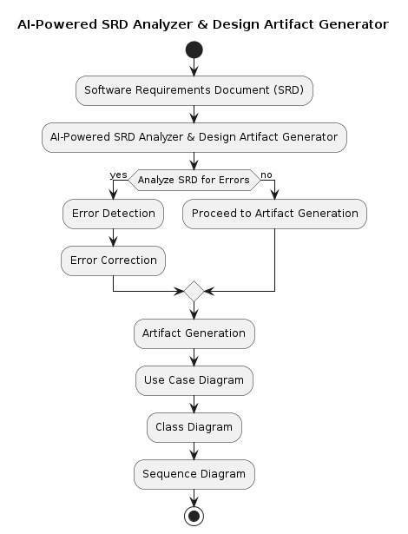
AI-Driven SRD Analysis and Automated Design Artifact Generation
Analyzing visual mockups, diagrams, and data representations
Utilizing object detection, scene understanding, and OCR
Creating a unified understanding of visual and textual requirements
Incorporating visual information into design artifacts

Slide 6
From User Narrative to Unified Implementation
Enhancing User Stories with RAG-driven Use Case Diagrams for Comprehensive System Understanding."
Augmenting Requirements with Retrieval Techniques for Accurate and Efficient Code Generation."
Streamlining Development: From Narrative Requirements to Functional Code with RAG Integration
User story to use case diagram (with RAG)
Requirement to code snippet (with retrieval augmentation)

Slide 7
Addressing Challenges in AI Systems
Data quality and bias mitigation
Security and privacy concerns
Explainability and user trust
System complexity and scalability

Slide 8
Conclusion:
Reiterate the key benefits of using AI for SRD analysis and design.
Emphasize the potential of this approach to revolutionize software development.
Encourage further exploration and collaboration in this field

